Slide 1
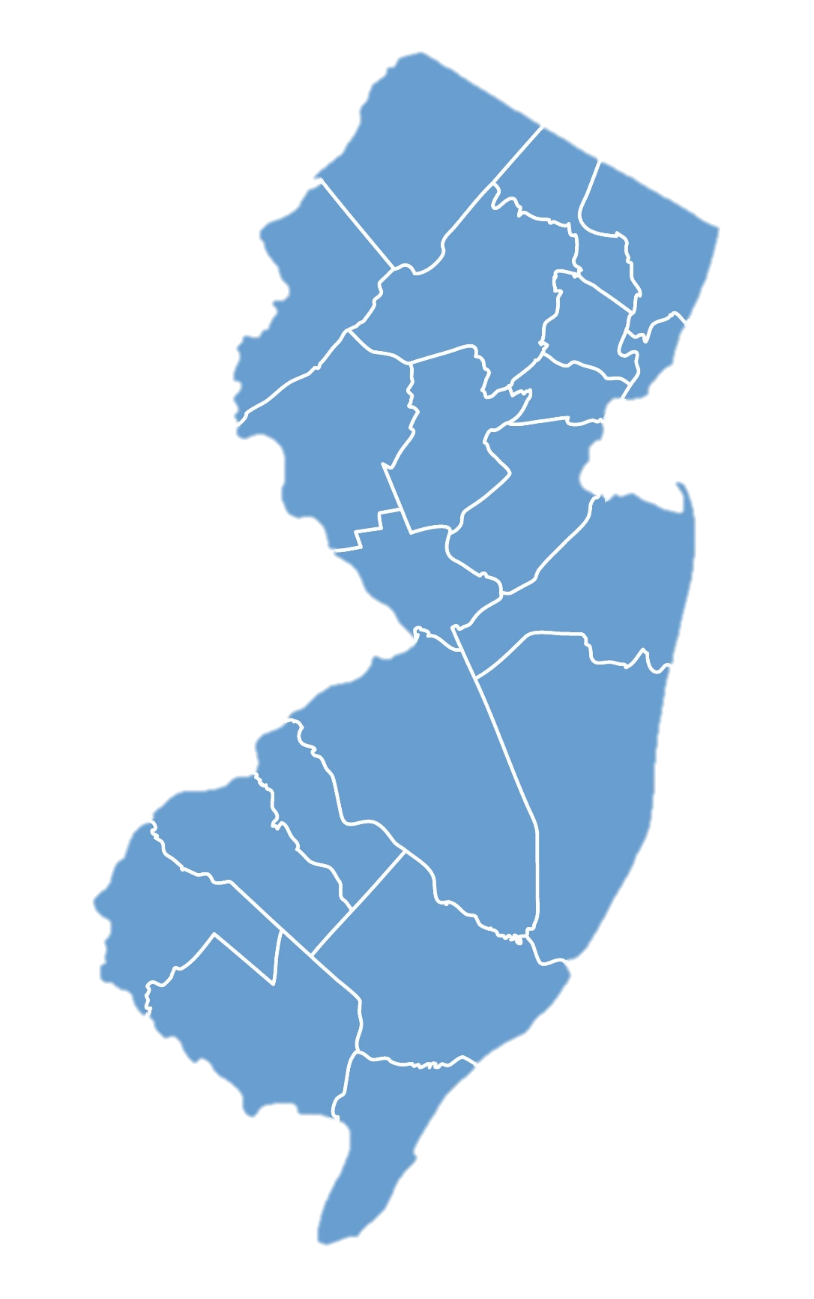

NICKY FIFTH’S NEW JERSEY
N5NJ
SECONDARY PROGRAM
EDUCATION
The Arts

Slide 2

How are the Arts doing, when it comes to their inclusion in schools?
The numbers are as follows: 96% of Elementary School, 89% Middle School and 50% of High School Students are actively participating in the arts. More than one million students participated in public school arts education programs during the most recent school year according to data released by the New Jersey Department of Education and analyzed by the New Jersey Arts Education Partnership. There is an increase in high school arts participation for the third straight year with significant increases in dance and theater enrollment. For the first time, middle school data reveals 89% of all students participating in one or more art form while 94% of elementary students engage in arts learning.
http://artsednj.org/state-of-the-arts-one-million-public-school-students-participate-in-arts-education

Slide 3
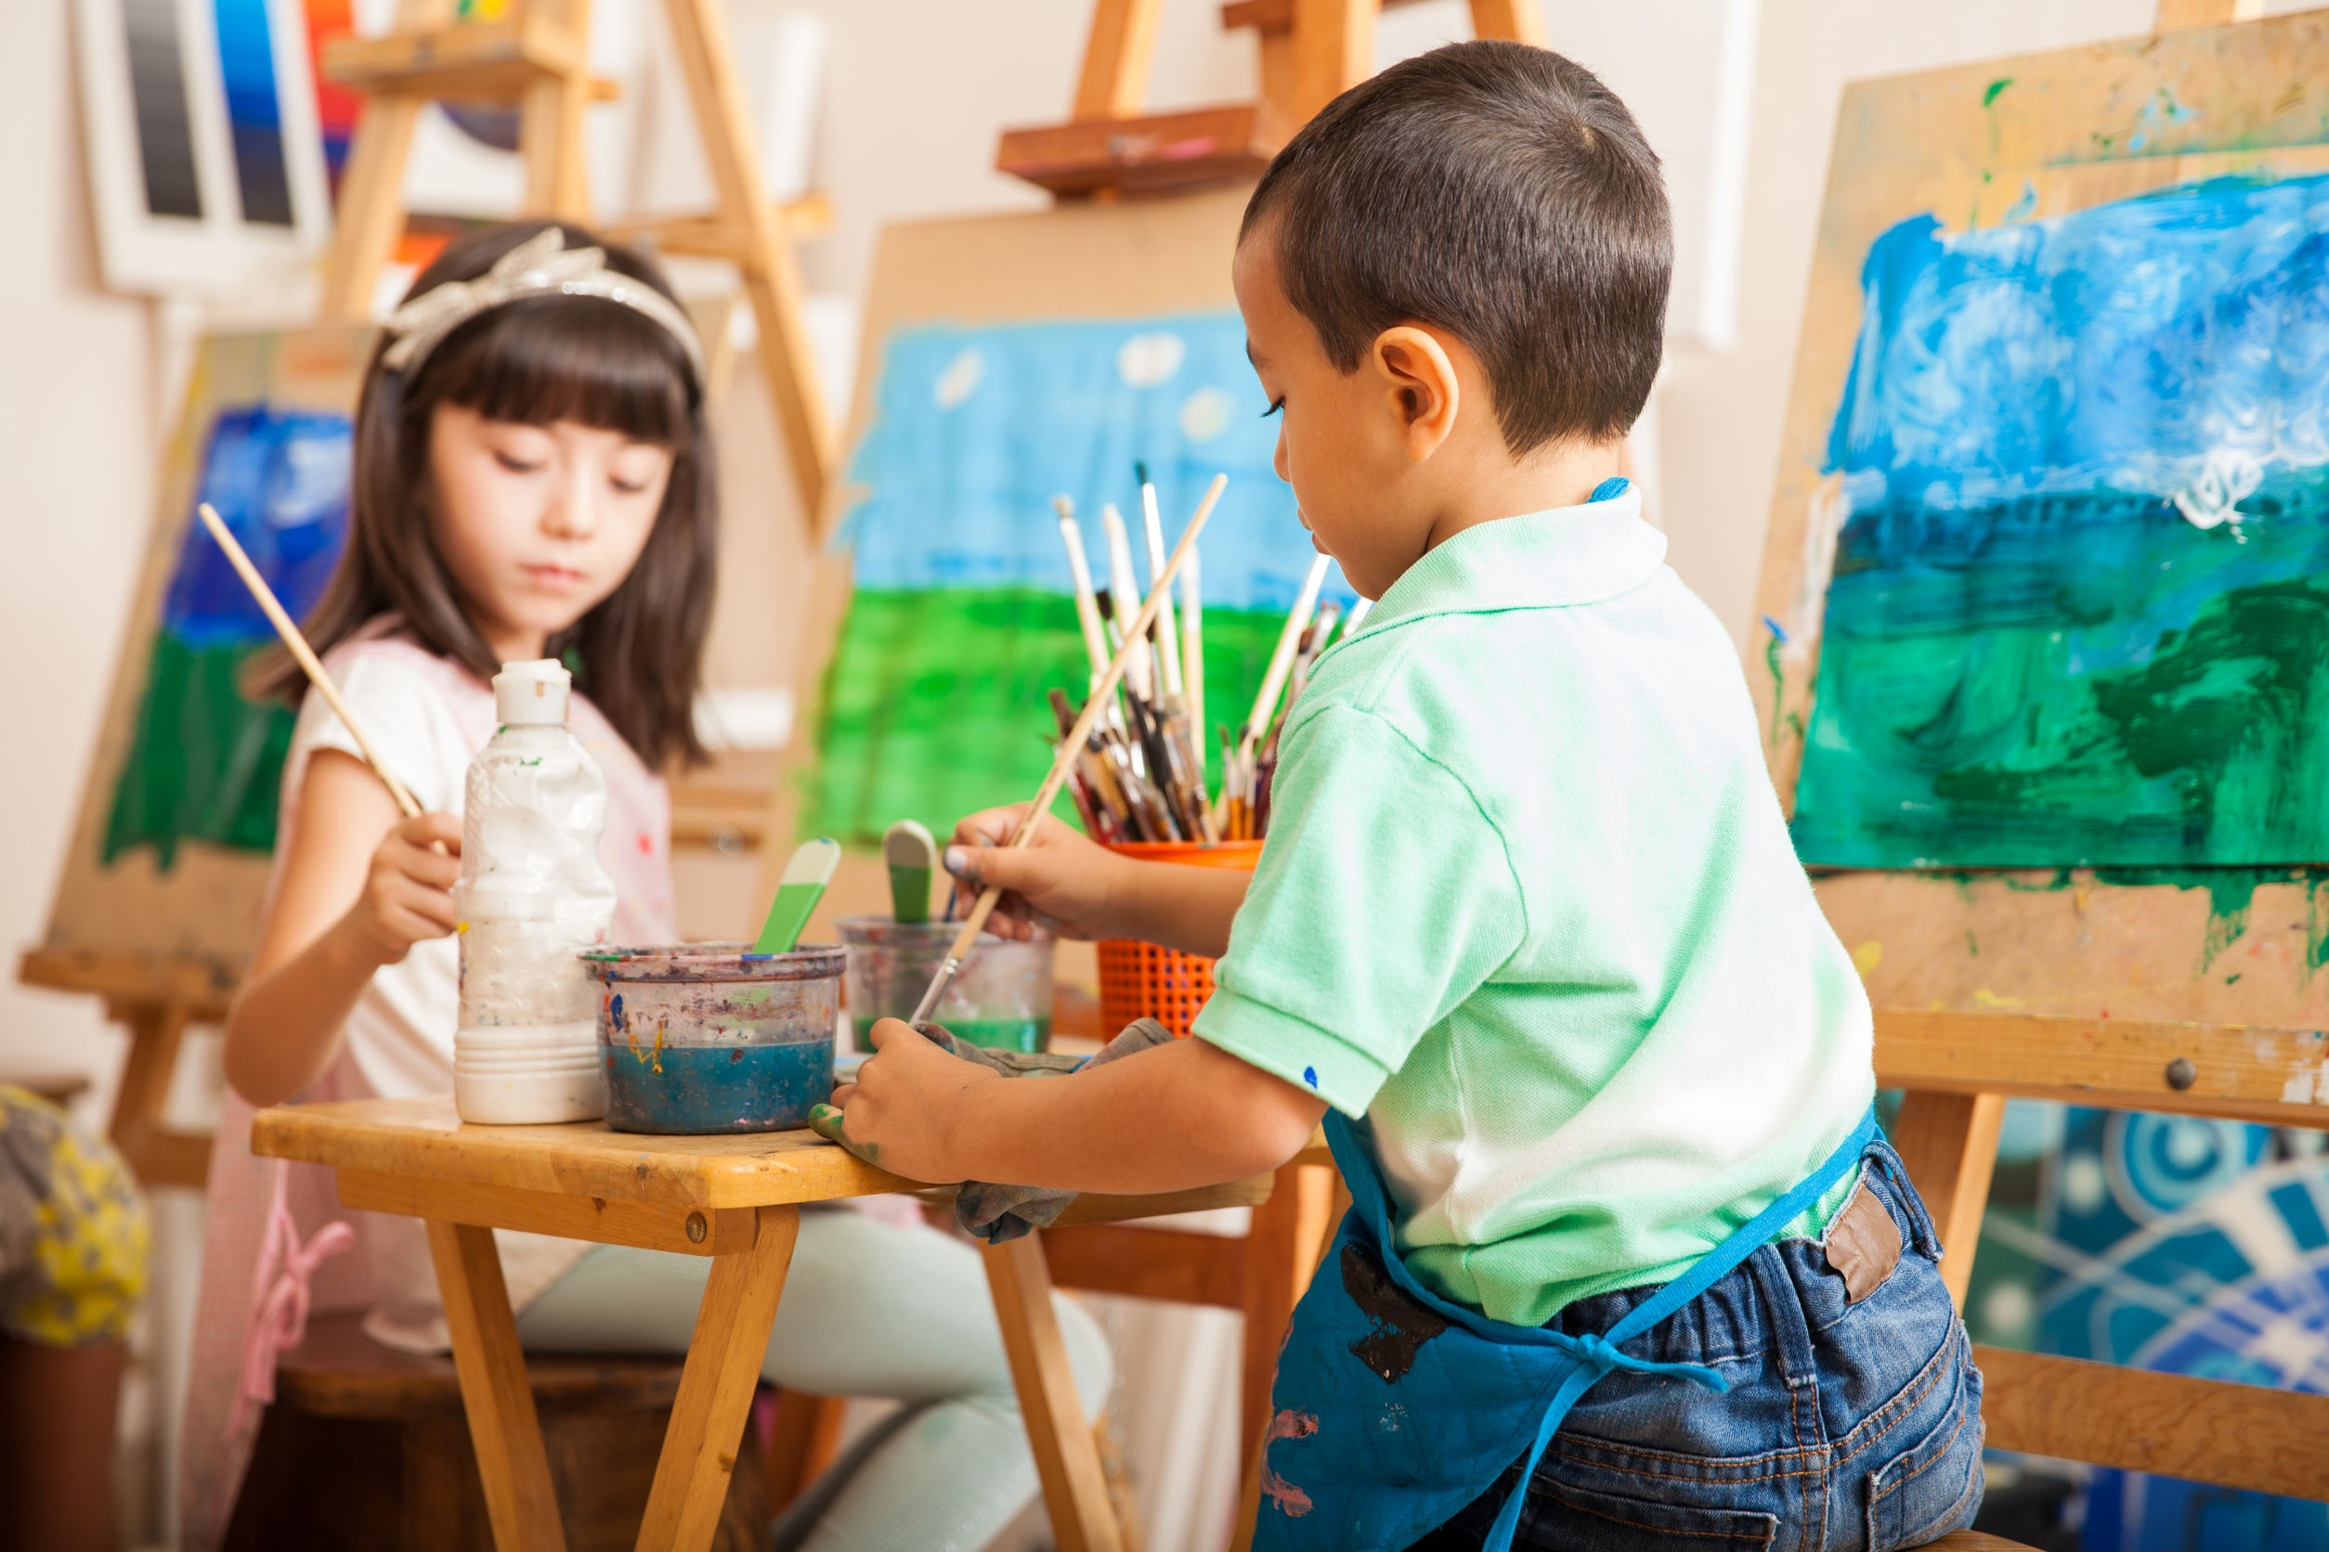
According to the new state data, 96% of schools in New Jersey reported offering arts education programs that provide access to more than 1.3 million students (98% of all students) with more than 1 million students participating in one or more arts areas during the school day representing 81% of all students in New Jersey schools.
http://artsednj.org/state-of-the-arts-one-million-public-school-students-participate-in-arts-education
shutterstock.com

Slide 4
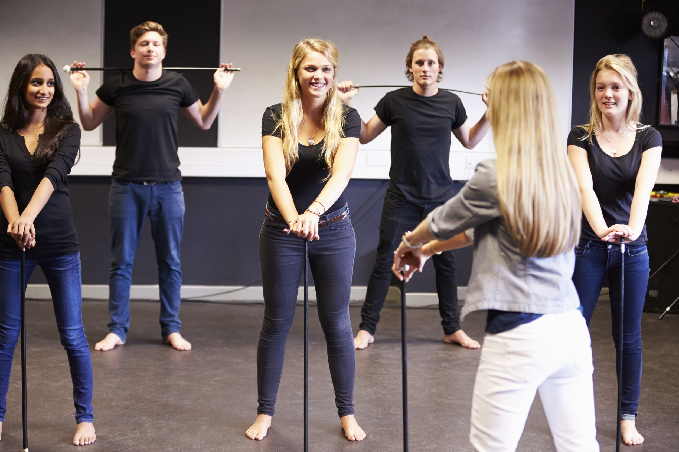
Student participation in high school arts programs increased to just under 50% of all students.
http://artsednj.org/state-of-the-arts-one-million-public-school-students-participate-in-arts-education
shutterstock.com

Slide 5
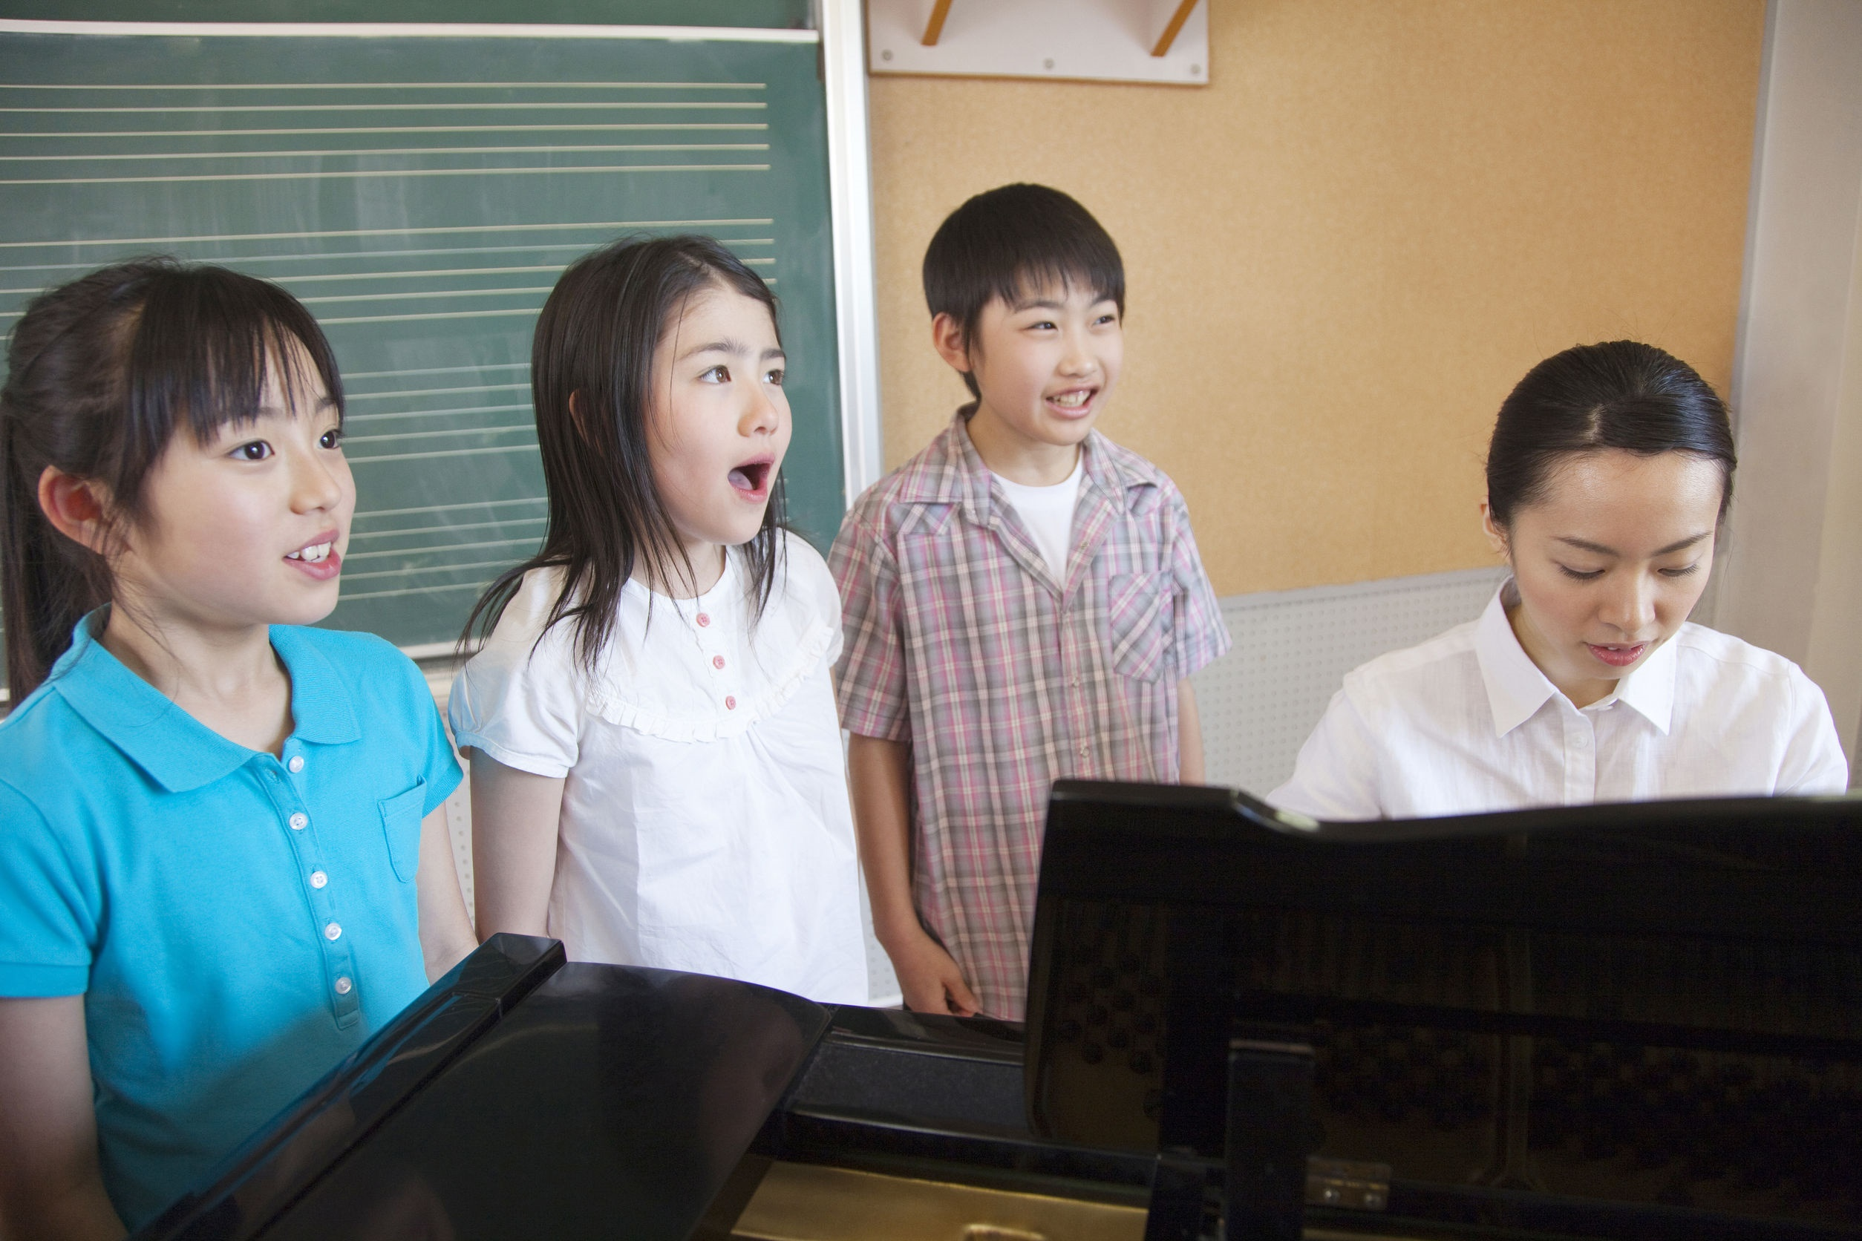
According to Morrison, the findings also reveal that Music and Visual Art are nearly universally available (90% of schools reaching 92% of students for Music and 90% of schools reaching 91% of students for Visual Art). While dance and theater have shown enrollment gains, the lack of access to these art forms at the elementary level creates a significant barrier to participation for students during middle school and high school.
http://artsednj.org/state-of-the-arts-one-million-public-school-students-participate-in-arts-education
shutterstock.com

Slide 6

A total of 49.9% of high school students were enrolled in one or more arts disciplines during the 2014/2015 school year (representing 204,974 unique students). This represents an 11% growth in arts enrollment since 2013.
Among the arts disciplines, visual art has the greatest percentage of enrollment at 31.1% (128,293 students) followed by music at 17.9% (72,823 students), theater at 3.9% (16,995 students) and dance at 2.3% (8,369 students).
http://artsednj.org/state-of-the-arts-one-million-public-school-students-participate-in-arts-education
shutterstock.com

Slide 7
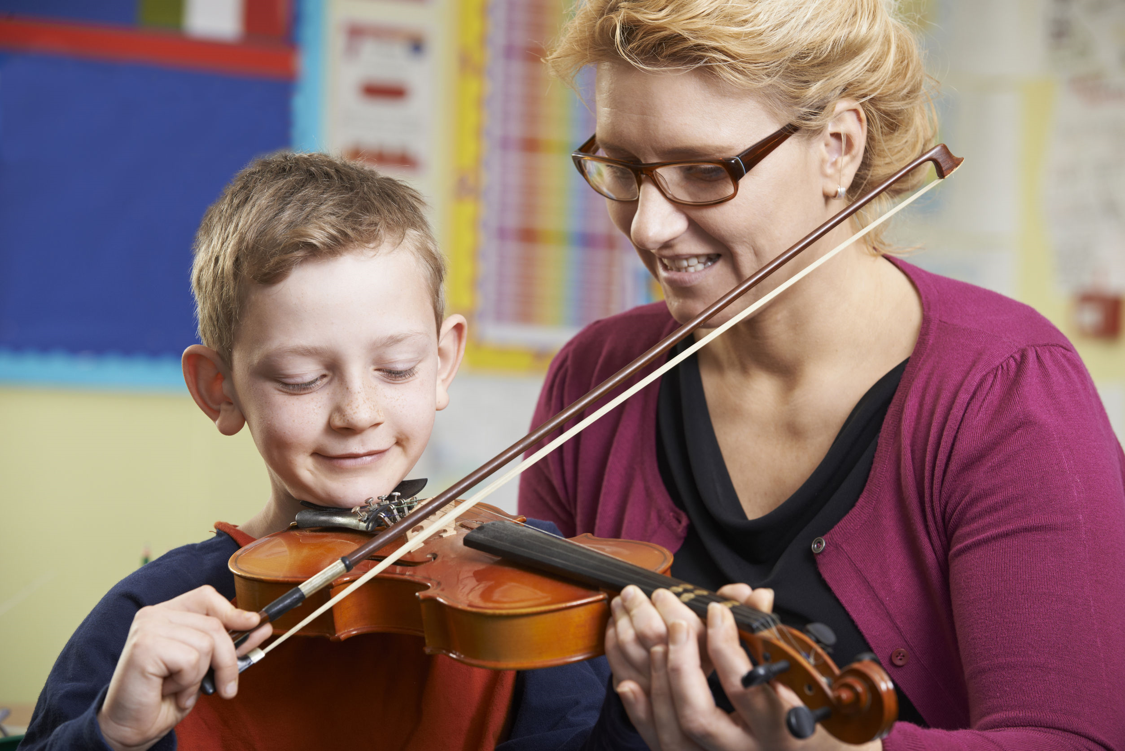
There are 7,033 professional arts educators providing arts instruction in New Jersey high schools (including 3,562 in music, 3,086 in Visual Arts, 63 in Theater and 112 in Dance with 162 in Vocational Education. 85% of all arts teachers are assigned to one school.
While 99% of middle school students had access to one or more arts offering during the school day – a total of 89.9% of middle school students actually participated in arts courses during the 2014/2015 school year (representing 339,425 unique students).
http://artsednj.org/state-of-the-arts-one-million-public-school-students-participate-in-arts-education
shutterstock.com

Slide 8

Among the arts disciplines, visual art has the greatest percentage of enrollment at 71.1% (281,465 students) followed by music at 66% (255,372 students), theater at 3.9% (13,749 students) and dance at 1.6% (7,202 students).
Among middle schools, 93% of students had access to both music and visual art.
http://artsednj.org/state-of-the-arts-one-million-public-school-students-participate-in-arts-education
shutterstock.com

Slide 9
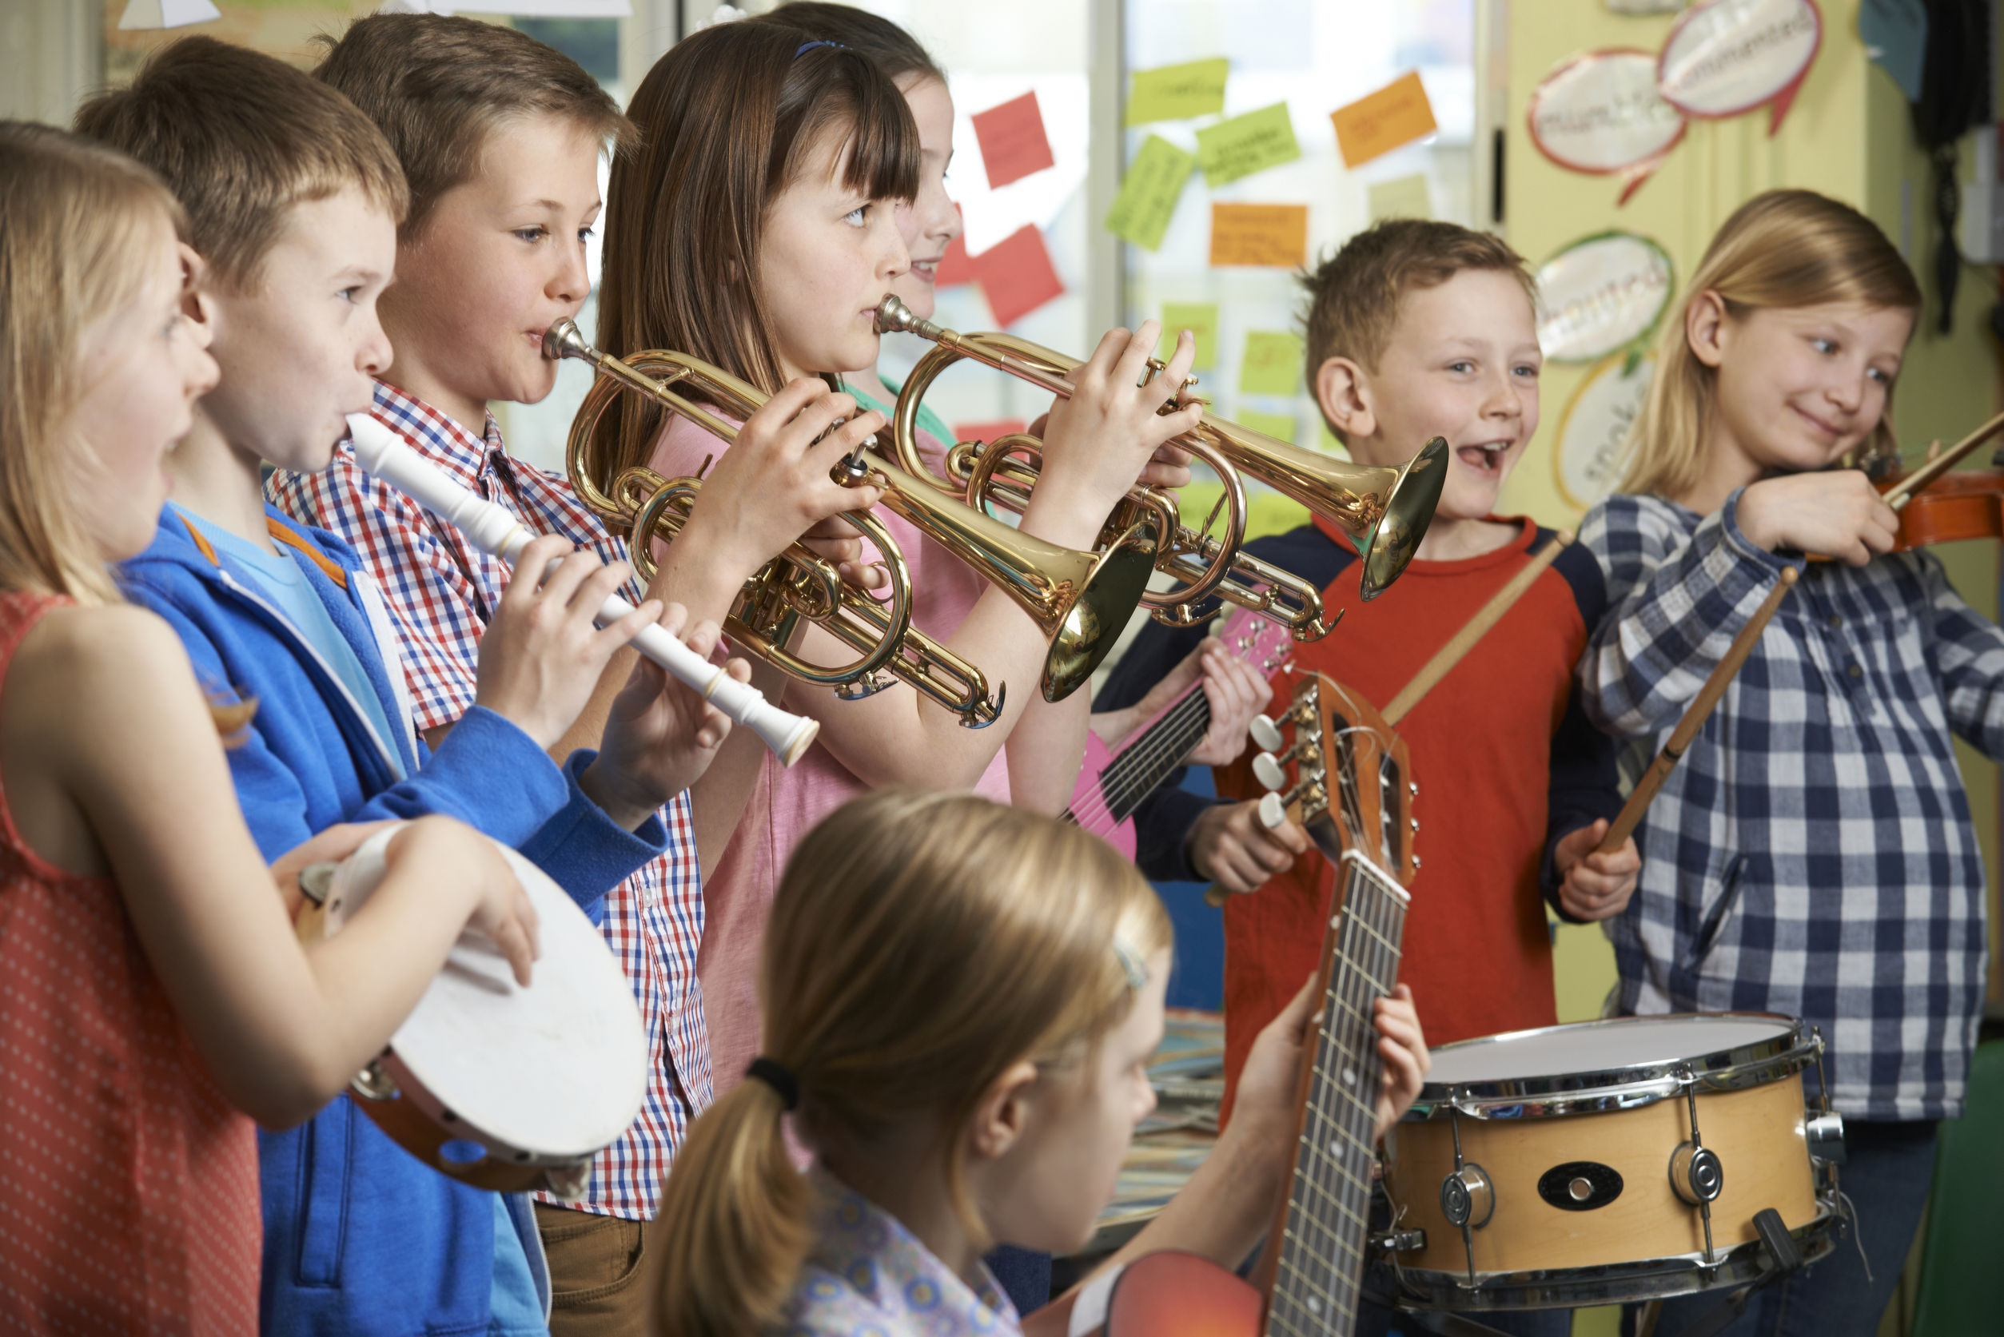
96% of elementary students had access to one or more arts offering during the school day or more than 520,000 students. Based on the structure of elementary schools, the presence of an arts teacher indicates students in the school participate in the arts specialty area of the teacher.
Music is accessible to 91% of elementary students in 86% of elementary schools. Visual art is accessible to 88% of elementary students in 85% of elementary schools. Both music and visual art are accessible by 83% of elementary students in 78% of schools.
http://artsednj.org/state-of-the-arts-one-million-public-school-students-participate-in-arts-education
shutterstock.com

Slide 10
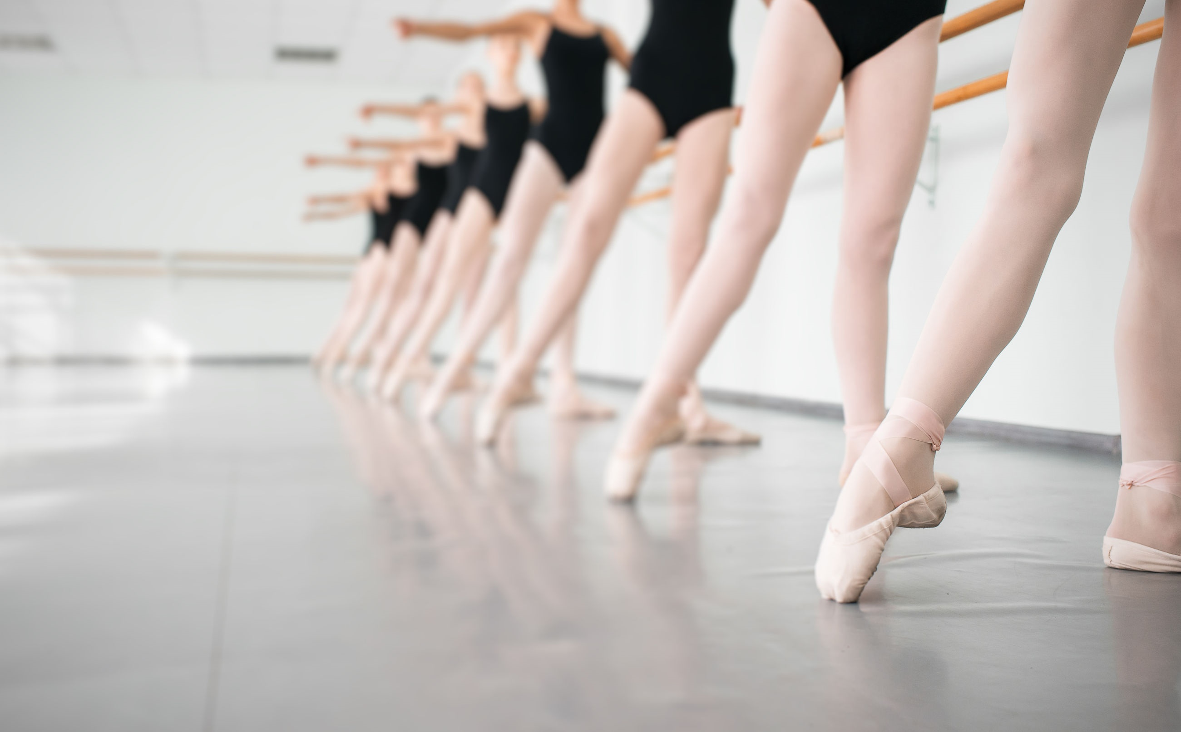
The picture for dance and theater is very different. Only 1.7% of elementary students have access to dance while less than 1% have access to theater during the school day.
New Jersey has long had some of the strongest requirements for arts education in the nation. Since 1996, the visual and performing arts (Dance, Music, Theater and Visual Arts) have been a part of the New Jersey Core Curriculum Content Standards and are part of the state’s graduation requirements. Additionally, New Jersey was the first state to conduct a mandated study to document access, participation and quality of arts education.
http://artsednj.org/state-of-the-arts-one-million-public-school-students-participate-in-arts-education
shutterstock.com

Slide 11

shutterstock.com
In support of these requirements, research regarding the educational benefits of the arts for all New Jersey students (not just the gifted and talented) is compelling. Various studies have identified links between involvement in the visual and performing arts and improved attendance, school engagement, increased academic performance, decreased drop out and discipline rates and higher levels of college attendance — areas of improvement vital to student success. Just as important, the arts develop important life skills including problem solving, critical thinking, creativity and collaboration.
http://artsednj.org/state-of-the-arts-one-million-public-school-students-participate-in-arts-education

Slide 12

A recent study found New Jersey high schools with more arts education have a greater percentage of students who were highly proficient in language arts on the High School Proficiency Assessment test.
High schools with more arts education have a higher percentage of students planning to enroll in a four-year college.
http://artsednj.org/state-of-the-arts-one-million-public-school-students-participate-in-arts-education
shutterstock.com

Slide 13
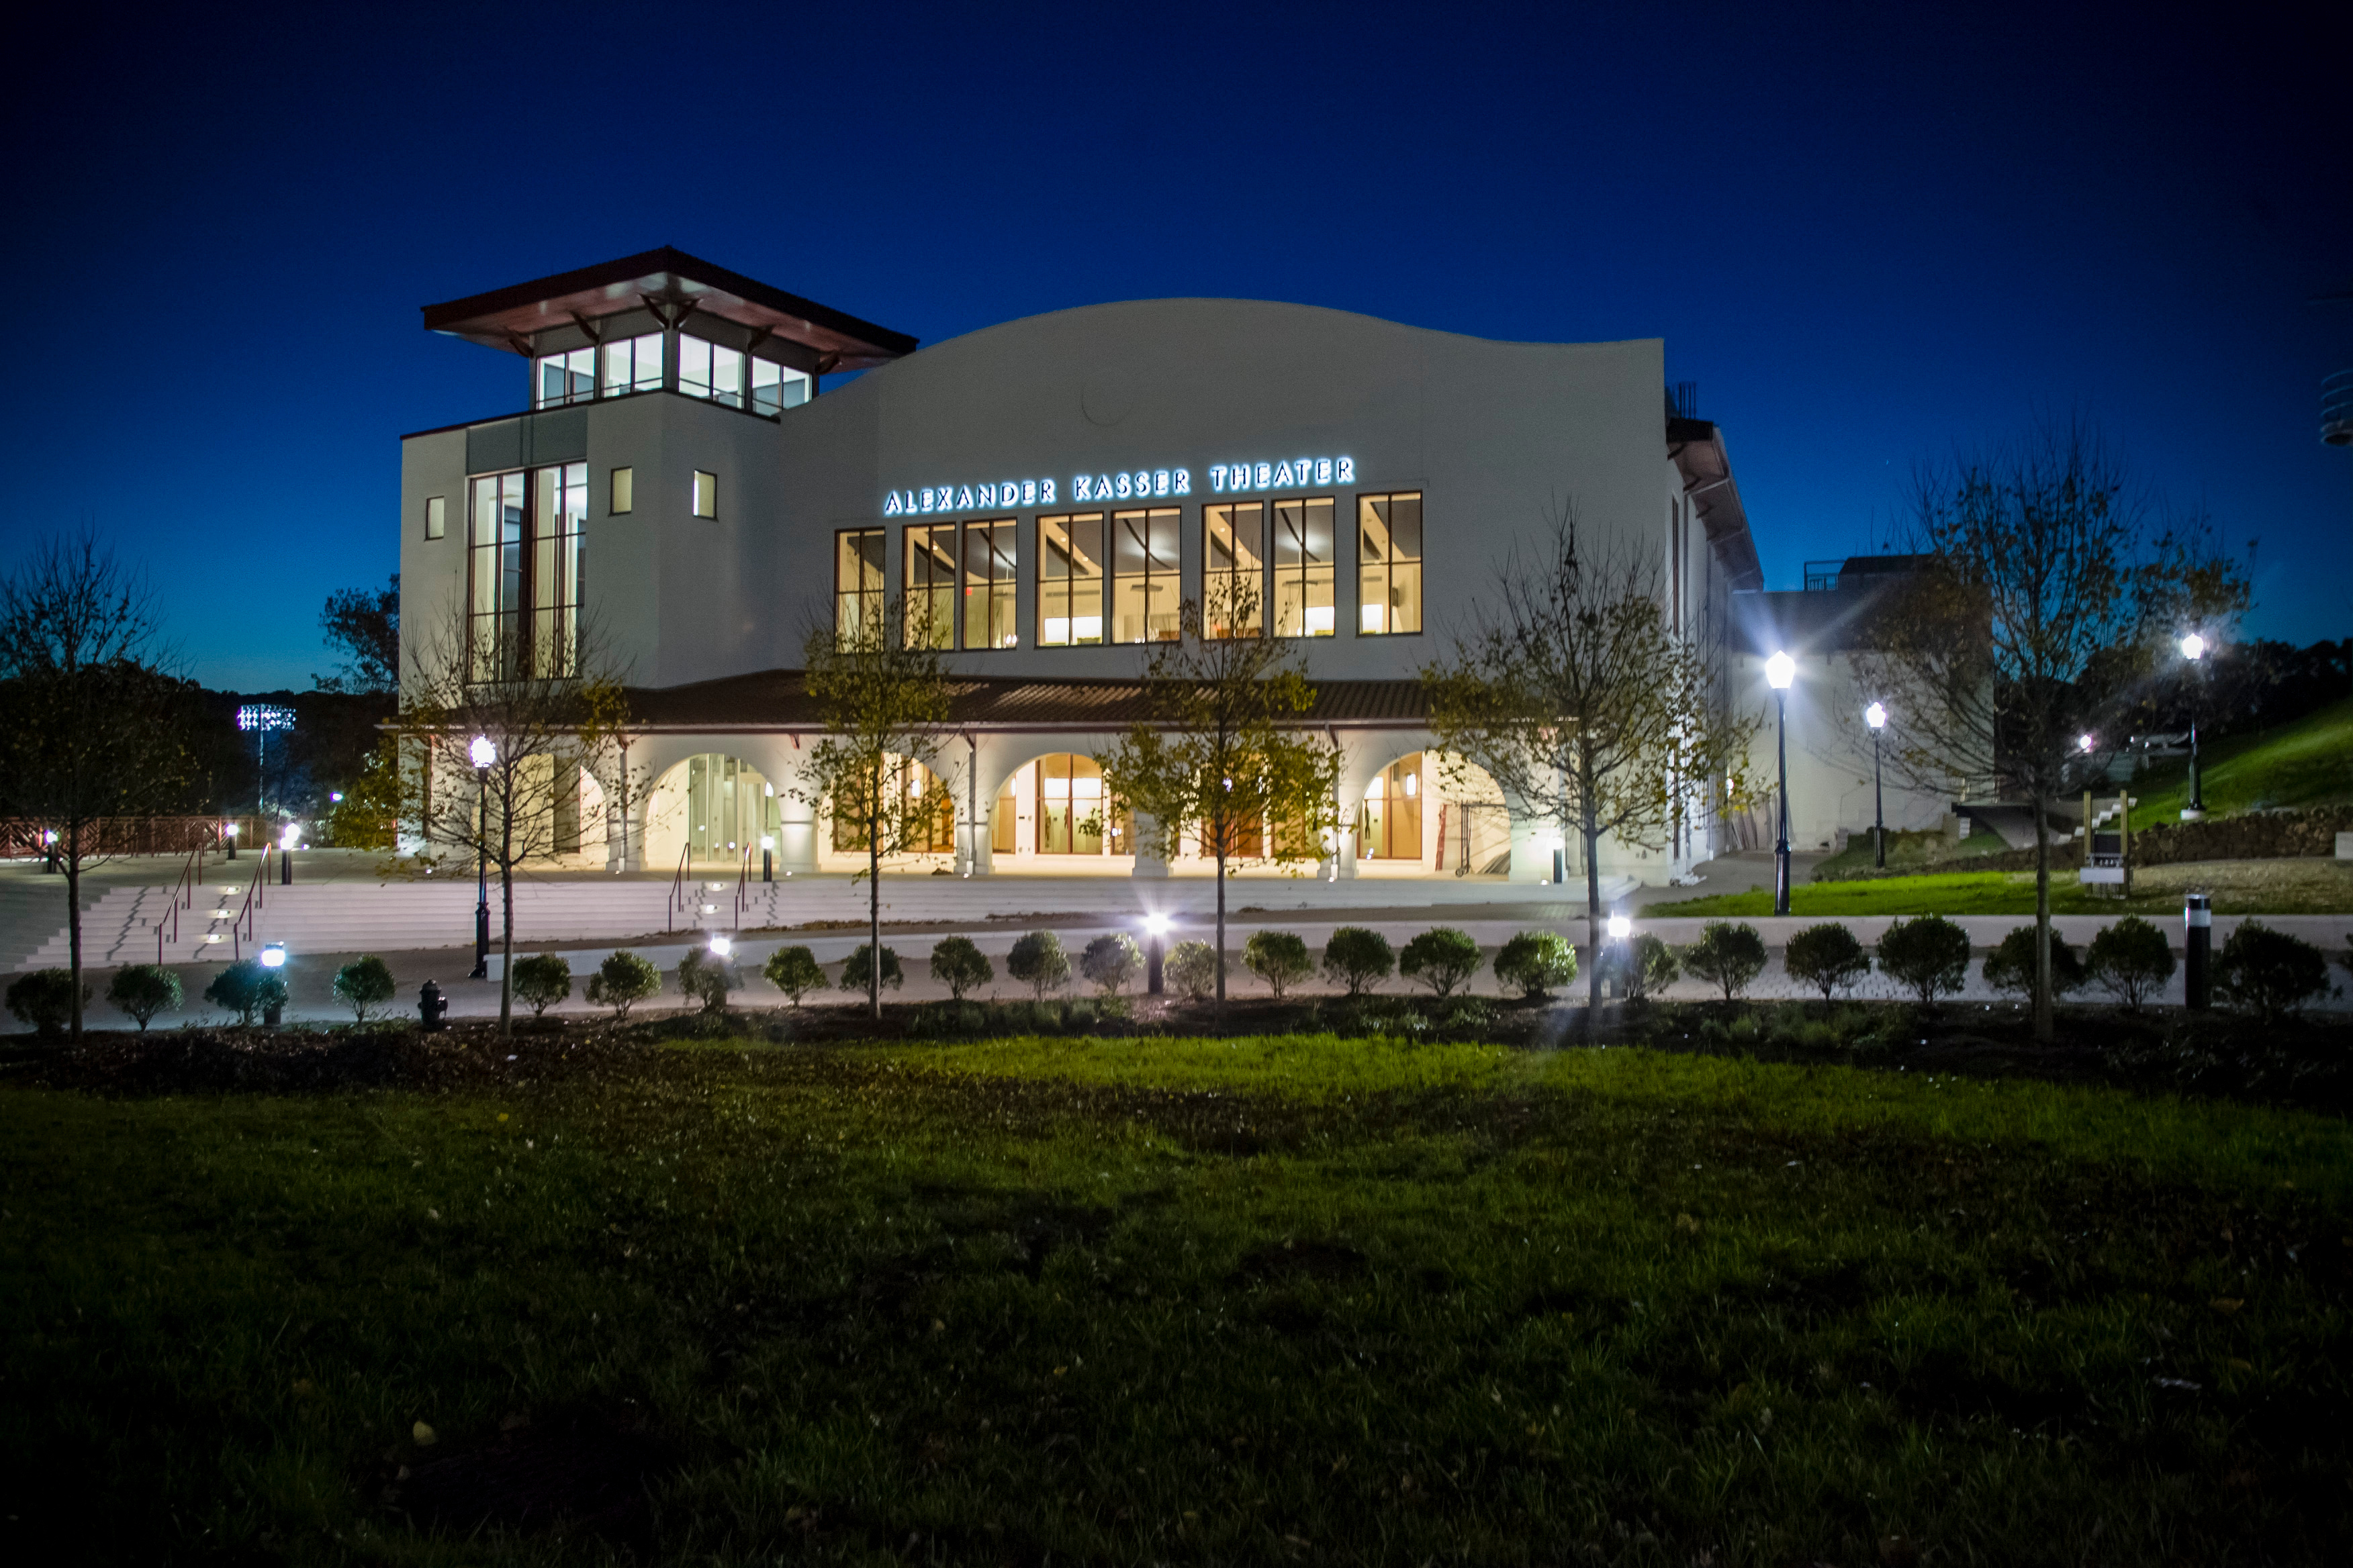
Montclair State University
shutterstock.com
Forty-six New Jersey colleges offer certificates, associate's, bachelor's, master's, and doctoral degrees in performing arts, fine arts, and graphic design and animation and three more programs. Some of the best art programs are offered by Montclair State University. This college has excellent, quality programs evaluated with five stars for curriculum and four-star rating for teaching.
http://best-art-colleges.com/new-jersey

Slide 14

Key Words
arts education programs critical thinking dance
student participation visual Art access
elementary level arts disciplines muic
Vocational Education enrollment theater
strongest requirements decreased drop out fine arts
shutterstock.com

